Slide 1


HDSC Spring ‘23 Capstone Project Presentation
TEAM PYSPARK
Thank You

Slide 2
Using Diet Analysis to Predict and Prevent Child Malnutrition
August 2023

Slide 3
Our Team
Nikhita Ramachandran
Bertram Okwudili Nnalue
Alphonse Emmanuel Y Boudouin
Obiageli Jessica Okoli
Bilah Hajara
Jimoh Saheed
Olufemi Adejayan
John Mikky

Slide 4
Problem Statement
This project aims to leverage machine learning, data science, and data analysis to analyse diet patterns in children under 5 years old globally with the view of predicting and preventing malnutrition.
This is a direct continuation of the previous work done by Team Seaborn of HDSC ‘23 Winter Cohort.

Slide 5
Previous Work
Team Seaborn HDSC Winter Cohort 2023 worked on diet analysis for predicting child malnutrition but focused on just three burdens of malnutrition such as stunting, wasting and overweight over the period of 2000 – 2020.
Md. Merajul Islam et al [International Journal of Cognitive Computing in Engineering, June 2022] embarked on the application of Machine Learning Algorithms in predicting malnutrition amongst women in Bangladesh.
Focusing solely on Indian kids and how Stunting, Wasting and Underweight affects them, Sangita Khare et al [Procedia Computer Science 2017] applied normal linear regression to predict if there exists signs of malnutrition in kids by observing their nutritional status.
NHANES focused on dietary analysis and in turn classified the population as balanced, unbalanced and nearly unbalanced. Machine learning techniques were deployed to achieve this. It was a pointer to understanding how diets affects the populace.

Slide 6
Methodology
Our Approach to tackling the problem and proffering solutions is as follows;
Data Sourcing
Data Cleaning
Exploratory Data Analysis
Time Series Prediction
Feature Selection and Engineering
Modelling and Evaluation

Slide 7
Dataset Description
The dataset was sources from the United Nations International Children Emergency Fund (UNICEF) archives on child malnutrition.
It covers data from 346 geographic regions and their nutritional records from 1970 – 2022.
Upon cleaning and dropping of columns not needed, pivot tables based on the indicators and the year and countries respectively was created and the following indicators were selected. They are;
Stunting
Severe Stunting
Wasting
Severe Wasting
Underweight
Severe Underweight
Overweight
Obese

Slide 8
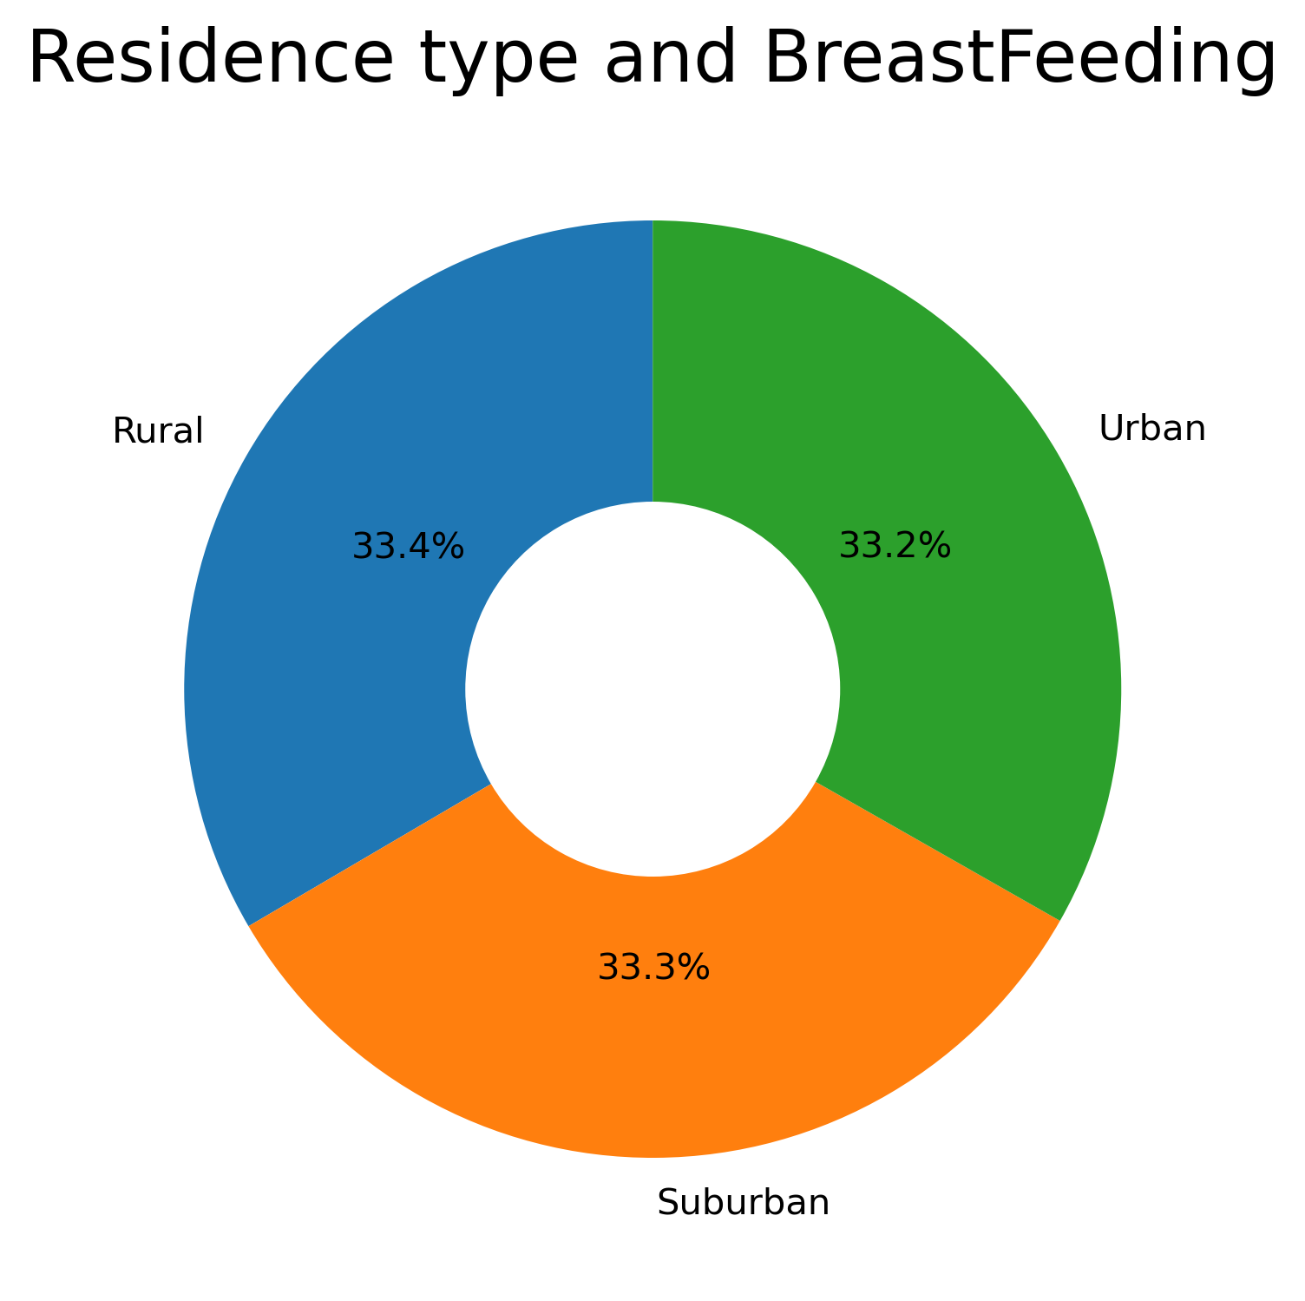
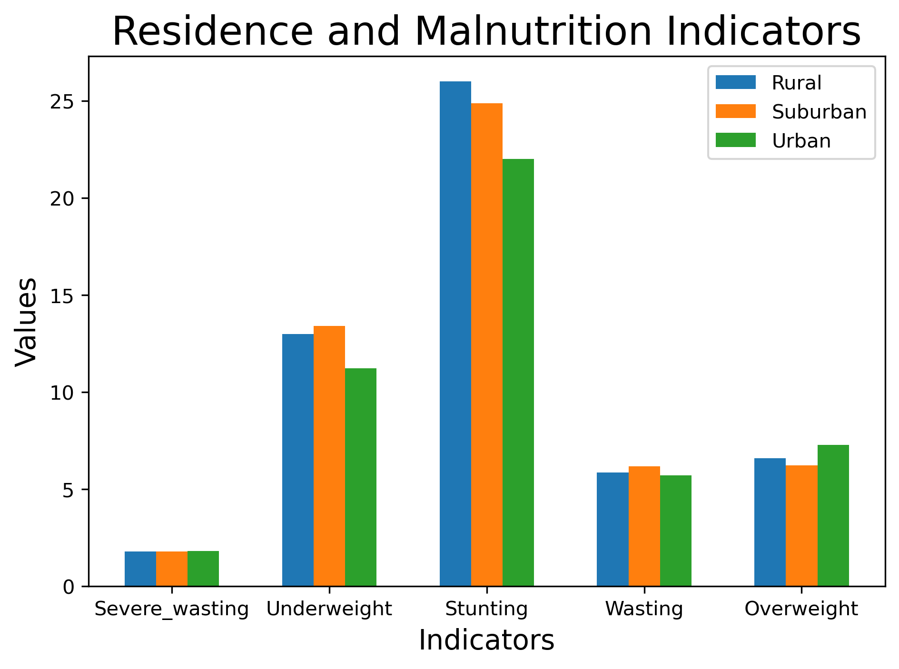
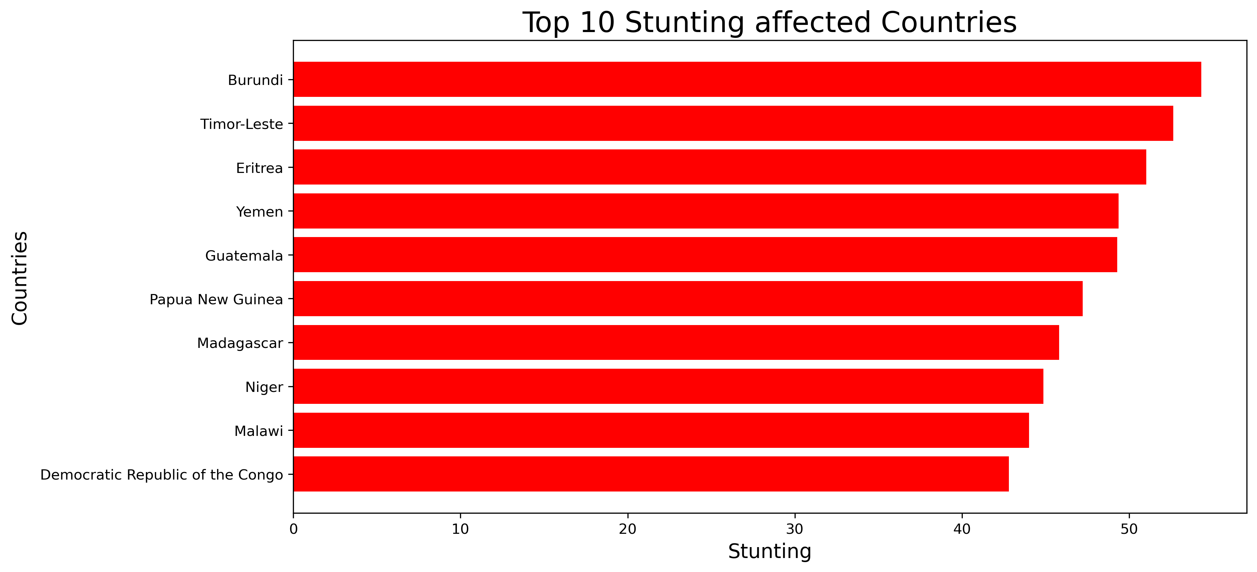
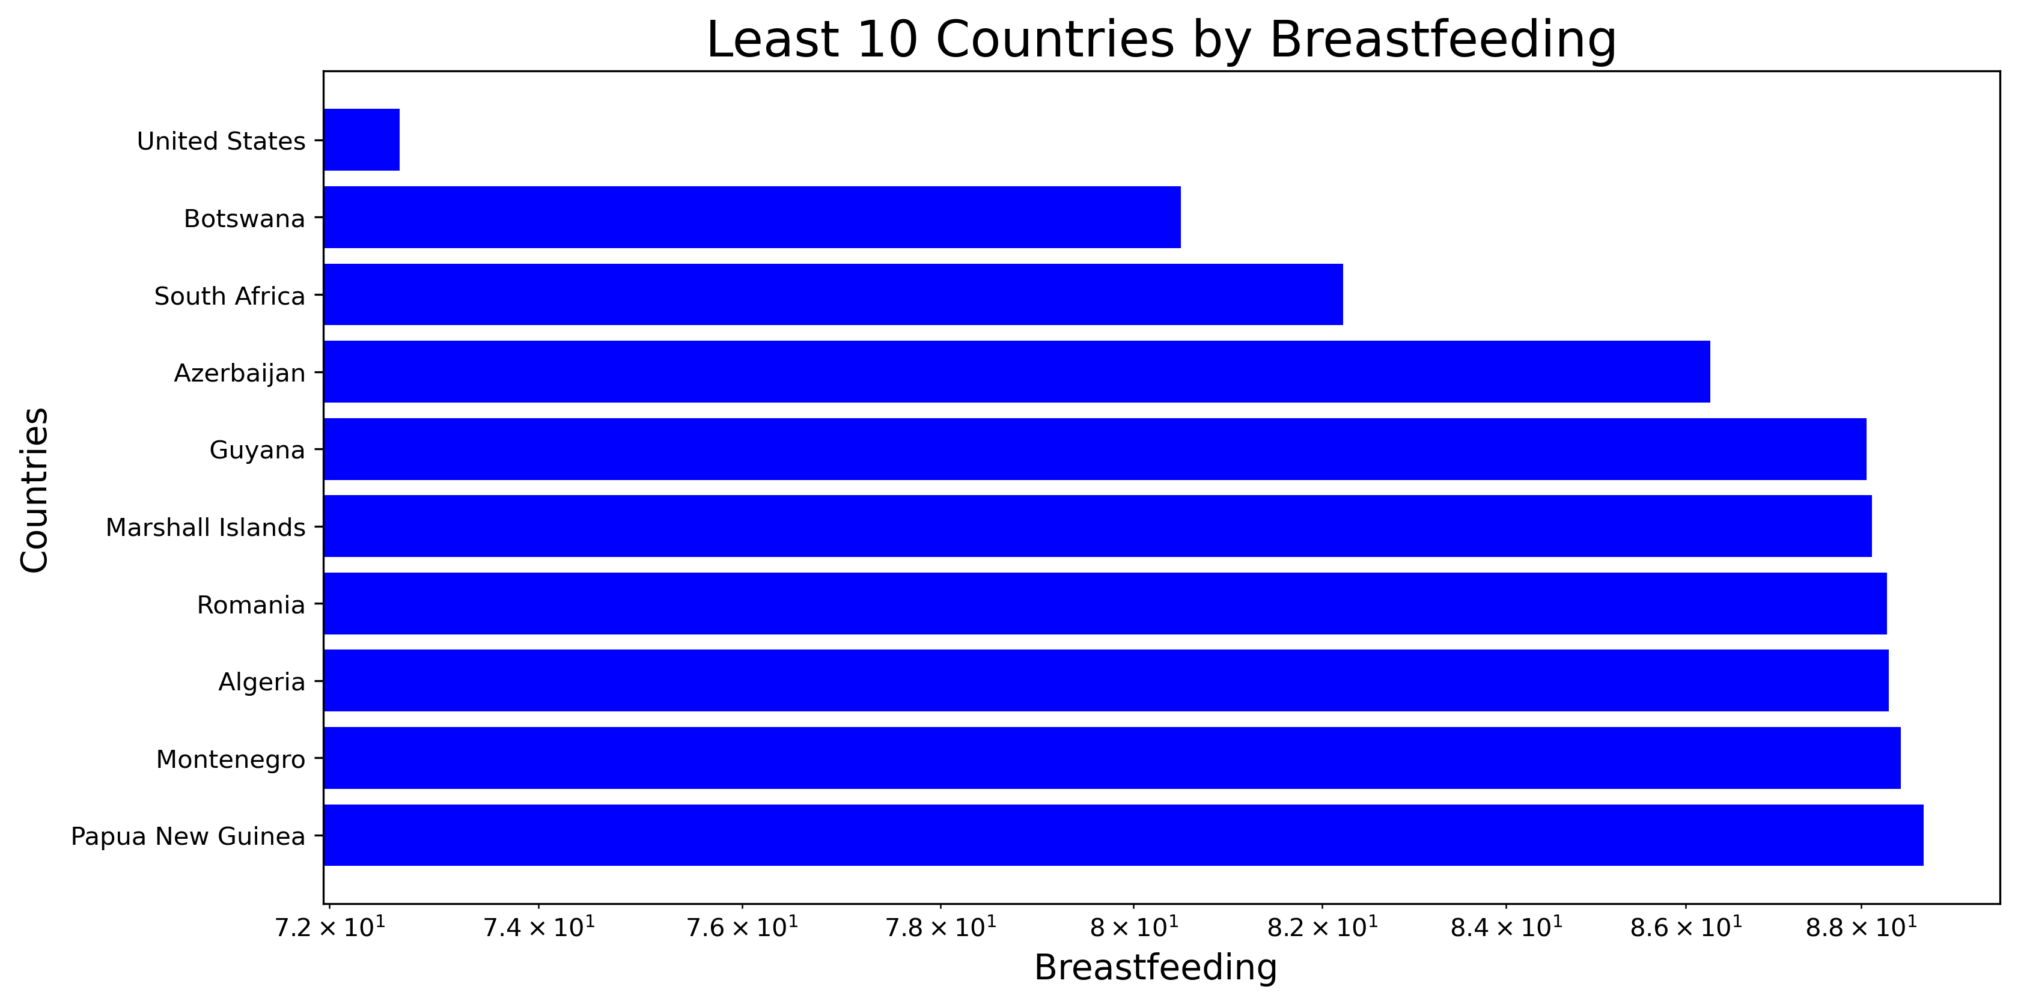
Exploratory Data Analysis
Upon EDA, lots of insights were gained from the dataset. They include some of these;
The rate of the burdens of malnutrition by each country
How maternal education affects the likely occurrence of malnutrition in a child
Residency types and its effect on child’s diet composition.
The Breastfeeding patterns of mothers in each country
Each country and the average minimum meal frequency of its populace

Slide 9
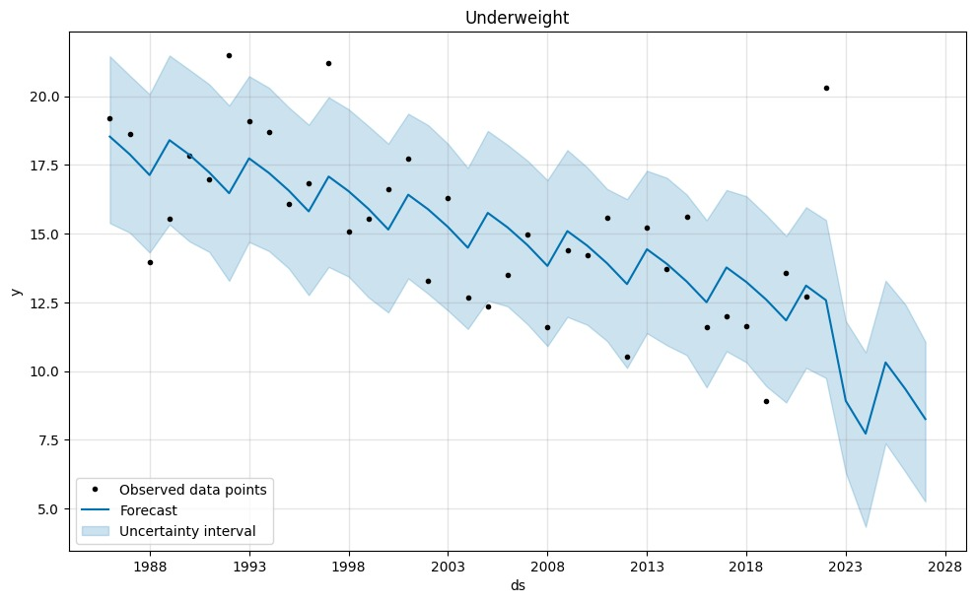
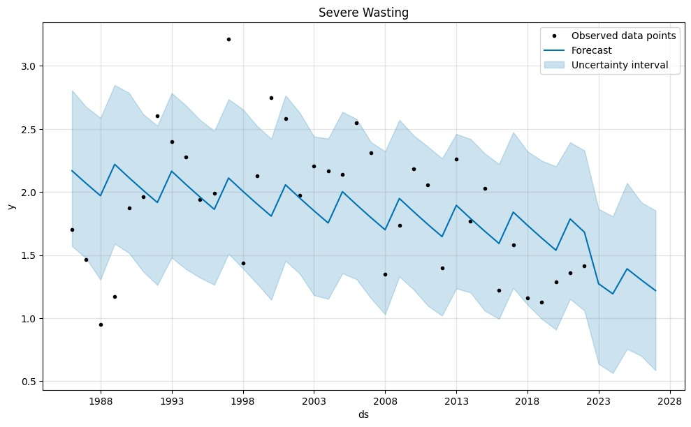
TIMES SERIES PREDICTION (2022 – 2028)
Severe Wasting: There is a downward trend which tried to increase in the year 2023 to 2024 but quickly reverted to its downward movement. This indicates lesser cases of severe wasting worldwide
.
Underweight: Globally, we shall be expecting a massive drop in underweight cases starting from 2022. Although it tried to raise its ugly head in 2025 but it was defeated and it continued its downward trend.

Slide 10
Model Training
Feature Selection and Engineering was carried out using the following;
Lasso Regression
Ridge Regression
Random Forest Regression
Machine learning models used includes;
ElasticNet giving MSE of 0.17895505880978693
XGBoost gave MSE of 0.2355057192012161
Linear Regression gave MSE of 0.20068247400023106
Gradient Boosting gave MSE of 0.18564662790538358
Deep learning architectures such as these where used;
Convolutional Neural Networks (CNN) has MSE of 0.18418040820425466
Recurrent Neural Networks (RNN) has MSE of 0.2705734372138977

Slide 11
Results
The research underscores the efficacy of AI models in predicting malnutrition indicators.
Model performances were evaluated using Mean Squared Error (MSE).
The Top performers were;
ElasticNet model
CNN
Gradient Boosting.

Slide 12
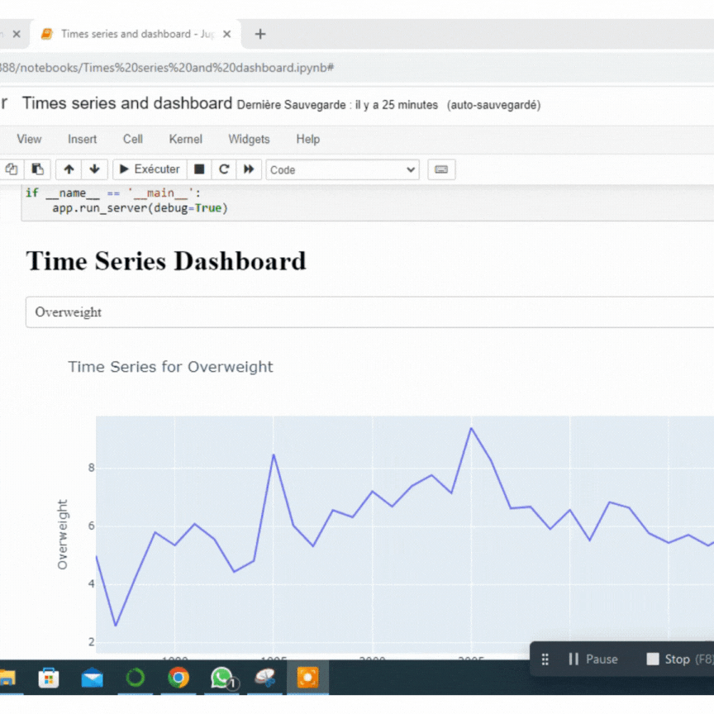
Dashboard

Slide 13
Summary
To combat malnutrition, we can do the following to achieve this goal;
Interventions should focus not only on increasing access to nutritious food but also on educating individuals about the importance of a balanced diet and healthy lifestyle choices.
Governments, healthcare professionals, and communities can use these dashboards to better understand the situation and educate people.
The predictions should be carefully studied and used as a guide in developing frameworks needed to fight these burdens of malnutrition.

Slide 14
Thank You
THANK YOU

